Slide 1
INTERNSHIP STUDIO
ETHICAL HACKING
TASK -1
DILIS DENNY

Slide 2
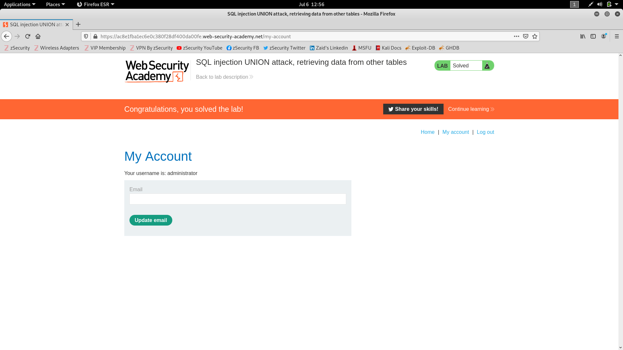

Slide 3
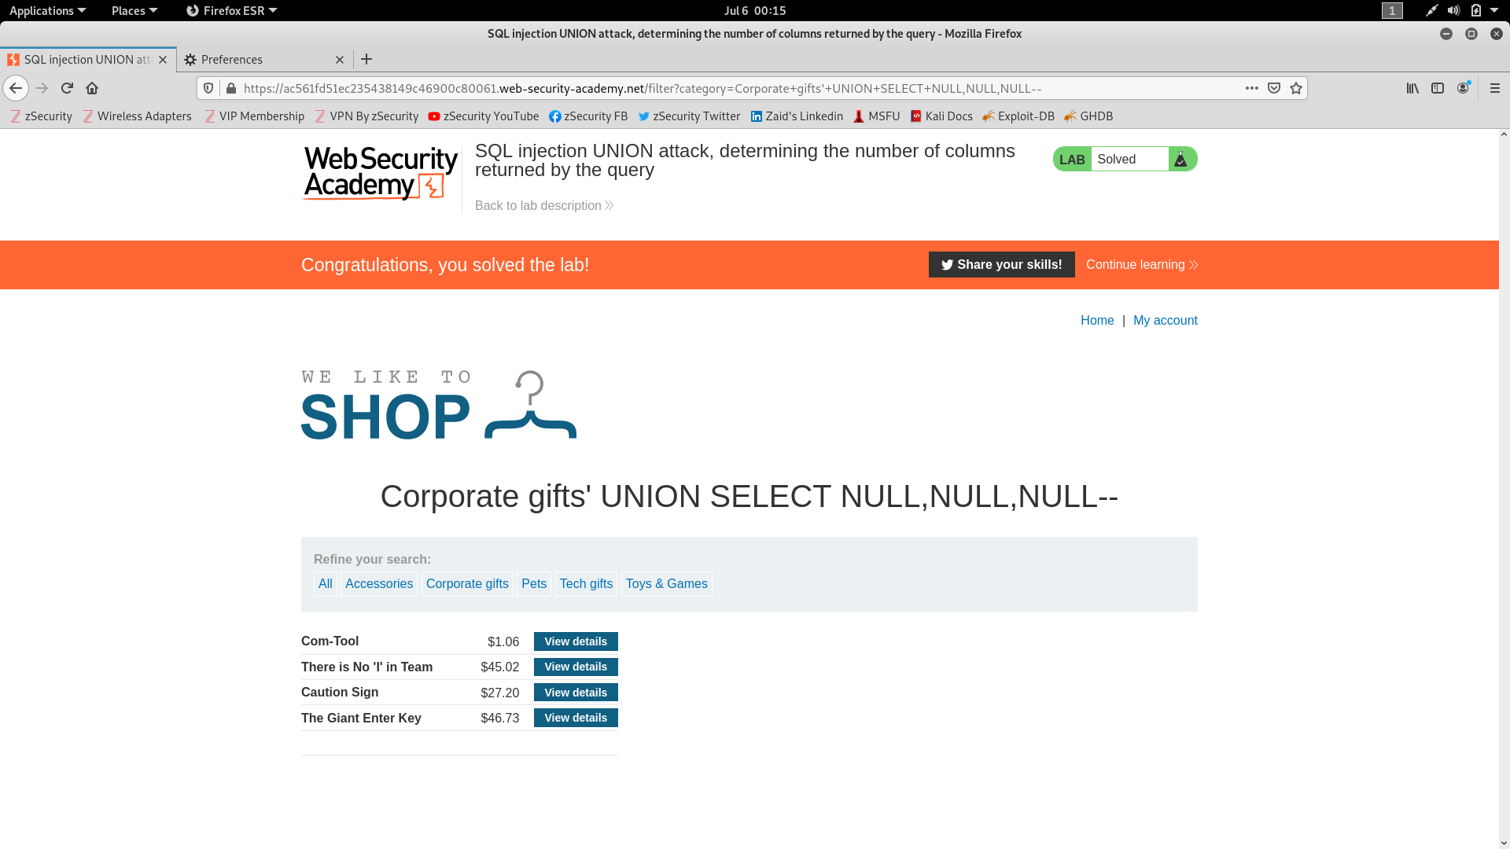

Slide 4
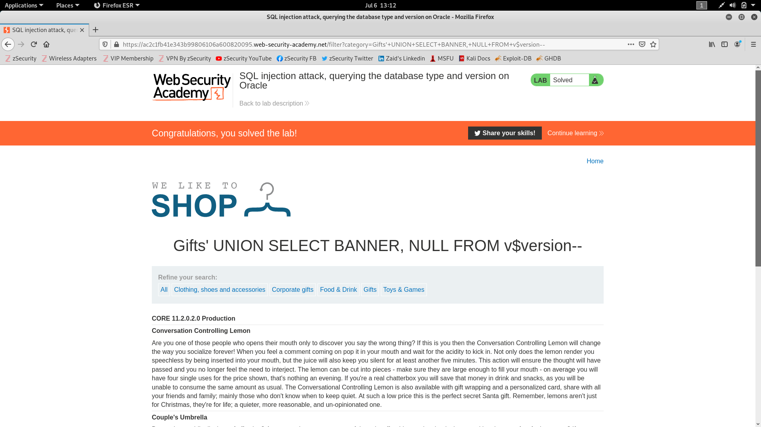

Slide 5
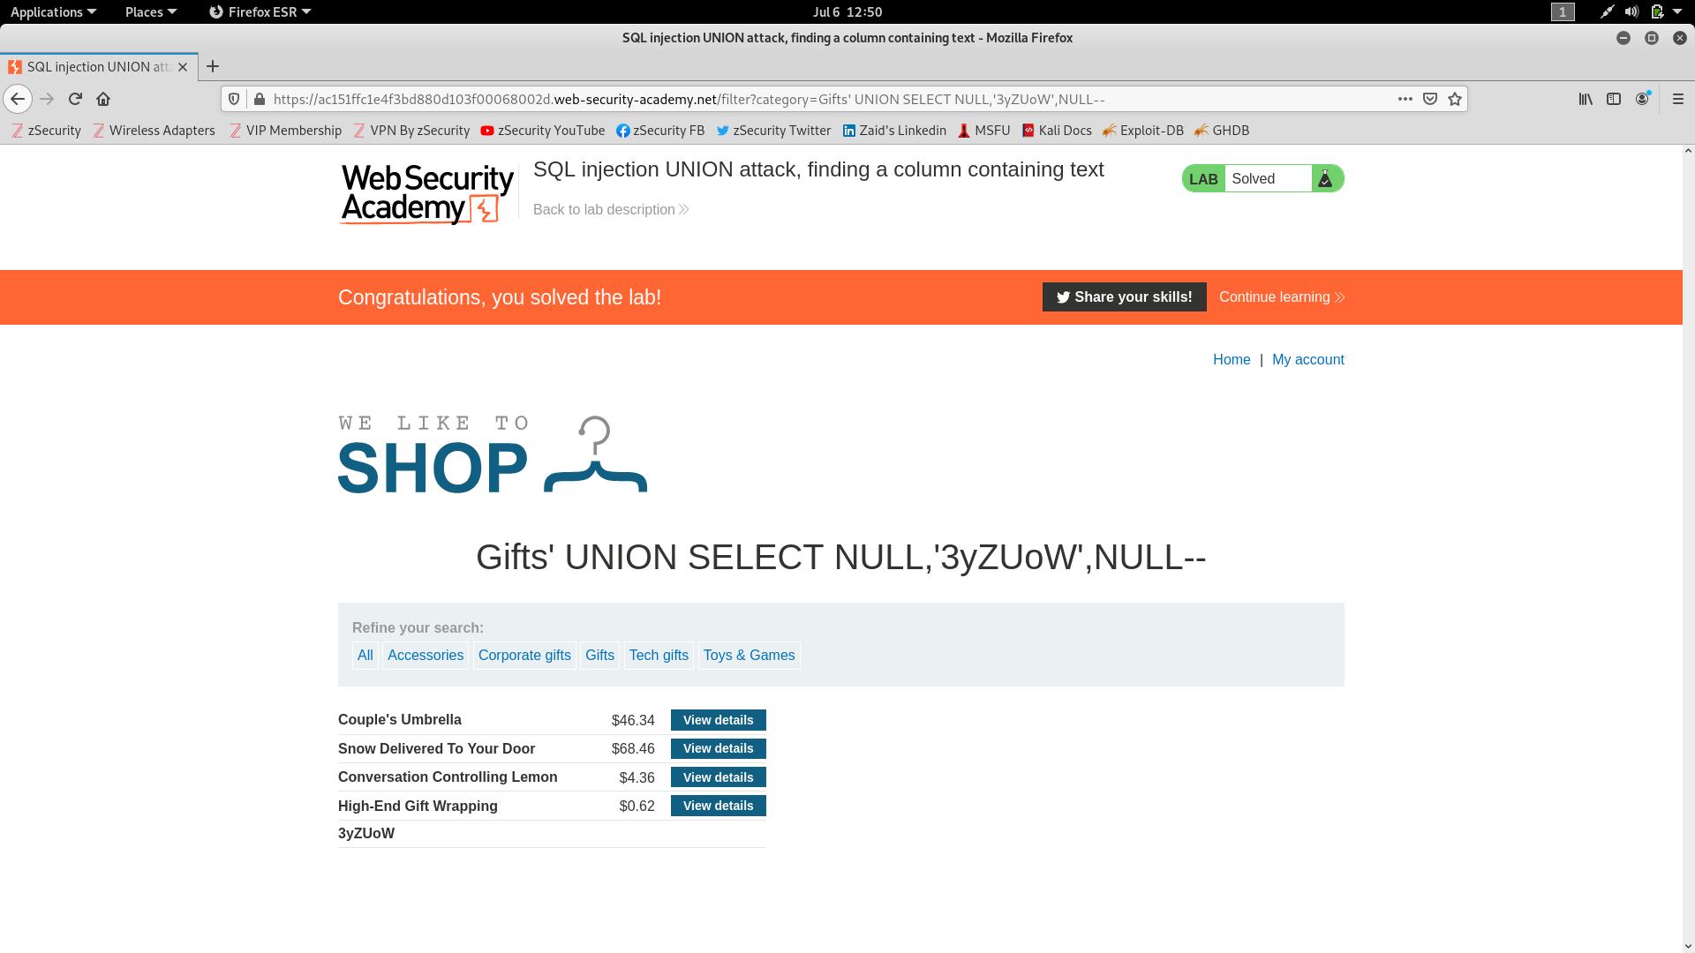

Slide 6
